Slide 1
R Markdown Templates
Presented by
Maulik Bhatt
R-Ladies Bangalore

Slide 2
Reasons to Use R Markdown
R Script contains only your code and comments, but not your output
R Markdown allows putting all contents together
This content includes your code, output and narrative/notes
Choice of output format (HTML/Word/PDF/Others)
You can revisit your own work at a later point of time
Reproducibility
Notes:
How presentation will benefit audience: Adult learners are more interested in a subject if they know how or why it is important to them.
Presenter’s level of expertise in the subject: Briefly state your credentials in this area, or explain why participants should listen to you.

Slide 3
Use cases for R Markdown Template
To submit your college assignments in a standard format
To submit your articles to journals in their standard format
To generate periodic reports in a standard format
To generate newsletters in a standard format
Notes:
Lesson descriptions should be brief.

Slide 4
How to create such a standard format
For a word document output, use the same “Reference Document”
---
Output: word_document
Reference_docx: “Template.docx”
---
For an HTML output, use the same css every time
For PDF output, use the same latex template
Notes:
Example objectives
At the end of this lesson, you will be able to:
Save files to the team Web server.
Move files to different locations on the team Web server.
Share files on the team Web server.

Slide 5
Disadvantages of the earlier approaches
You have to save the reference document/css file/latex template in each of the Rstudio project
If you change your mind, you will have to change these templates everywhere
That way, your research no more remains reproducible

Slide 6
R Markdown Template
Creating an R Markdown Template solves all the problems associated with the previous approaches
You have to store all the “Reference documents”/css/Latex templates only at one place
If you change your mind later, knitting the same document again creates the old document with the changed formatting

Slide 7
How to create an R Markdown Template
You need to create an R package for this
Creating such a package is easier than you think

Slide 8
Packages Required to Create Such a Package
Required Package
Usethis
Optional Packages (Depending upon your output format)
Bookdown (For output formats with cross-referencing)
Xaringan (For presentations)
Tinytex (to compile PDF documents)

Slide 9
Other Requirements
If your desired output is HTML, you need a browser installed on your computer
If your desired output is word document, you need Microsoft Word or OpenOffice installed on your computer
If your desired output is PDF document, you need LaTeX installed on your computer

Slide 10
Installing LaTeX For Your Operating System
For Windows OS, you can install MikTeX
For Mac OS, there is MacTeX
For Linux, you can install TeX Live

Slide 11
Problems with LaTeX Compilers
Sometimes it happens that your document cannot be compiled because of one or more missing packages
In such situation, you have to manually install the missing package(s)
Often, users are not even aware
How to install these packages
From where to install these packages

Slide 12
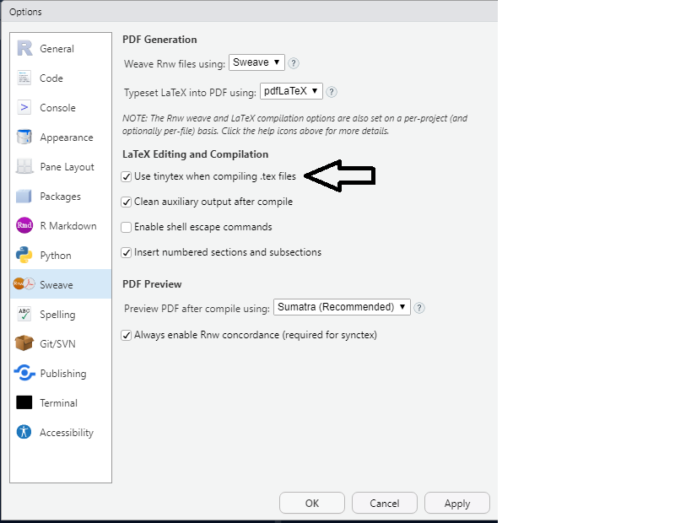
Using TinyTex

Slide 13
About TinyTex
There are two tinytex having the same name
An R package
A LaTeX compiler
The tinytex R package manages the installation and configuration of the LaTeX compiler TinyTex
The TinyTex LaTeX compiler would handle rendering the PDF output from R Markdown files
The TinyTex LaTeX compiler is based on Tex Live
Both, the R package and LaTeX compiler, are developed by Yihui Xie (who also developed other useful packages like knitr, R Markdown, Bookdown, etc.)

Slide 14
Installing LaTeX compiler TinyTex
The command tinytex::is_tinytex() #Checks whether TinyTex is installed
The command tinytex::install_tinytex() #Installs TinyTex and some of the basic LaTeX packages needed frequently
If you want more, you can also install other packages by using the command tinytex:::install_yihui_pkgs() #Remember there are three : symbols in this command
However, tinytex automatically installs missing packages as and when needed

Slide 15
Next Part of the Presentation in RStudio

